Slide 1
U.S. Public Policy Attack on Tobacco Use: Do These Policies Really Work?
Deepthi Dastari & Katrina Brundage
Notes:
When Katrina and I were brainstorming about the topic for this project, we both wanted to do something with the public data that is out there and we wanted our project to focus on something that has an impact on the society. And that was our motivation behind choosing to study tobacco usage rates in the United States. Katrina wanted to add a legal dimension to this topic, and we finally decided to study if these policies against tobacco use really work in terms of reducing tobacco usage.

Slide 2
Agenda
Background
Project Goal
Data Understanding
Modelling Approach
Logistic Regression
K-means Clustered Regression
Principal Component Analysis & Regression
Insights & Recommendations
Appendix

Slide 3
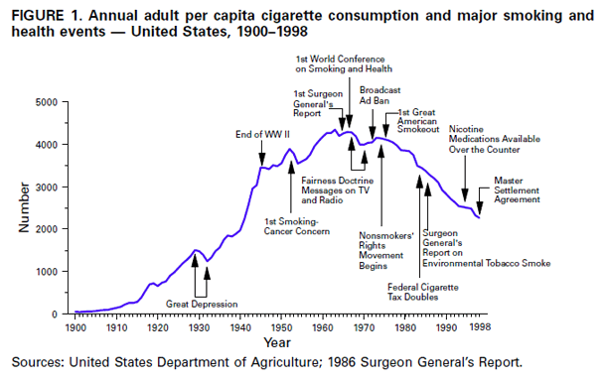
U.S. Smoking Trends
Cigarette Tax Increases
Tobacco Program Funding
Smokefree Indoors Legislation
2000 2010
Notes:
This slide shows how the cigarette consumption trends have changed over the years and the impact of historical developments on cigarette consumption.
We see that Smoking gained popularity in early 1900s and peaked in the 1960s. In 1965, the 1st Surgeon General’s report was published, which showed a correlation between smoking and lung cancer. It was after this report that the Centers for Disease Control (CDC) started tracking smoking rates. After the CDC started tracking the smoking rates and a few other developments, we saw a decreasing trend. In 1998, the Master Settlement Agreement was put in place, which set aside a lot of funding for Tobacco control programs. The decline continued and this was caused by Cigarette tax increases at the state and federal level, tobacco program funding and the smoke free indoors legislation.

Slide 4
Project Goal
Determine how
smokefree indoors legislation,
tobacco tax legislation,
and tobacco health policy funding
from 1996 to 2013 have impacted tobacco usage rates by State in the United States.

Slide 5
Data Understanding

Slide 6
% Smokers
by
Age Group
% Smokers
by Education
Smokefree Indoors Restrictions
State
Year
Cigarette Tax
/ pack
Smokefree Indoors Penalties
Funding Per Capita
Little Cigar Tax
/ pack
Notes:
We collected our data from the CDC public website.This slide shows the different data sets (5) and how we aggregated all those data sets by state and year.. The target data sets are in dark green(top) based on survey data .In grey are the input variables.

Slide 7
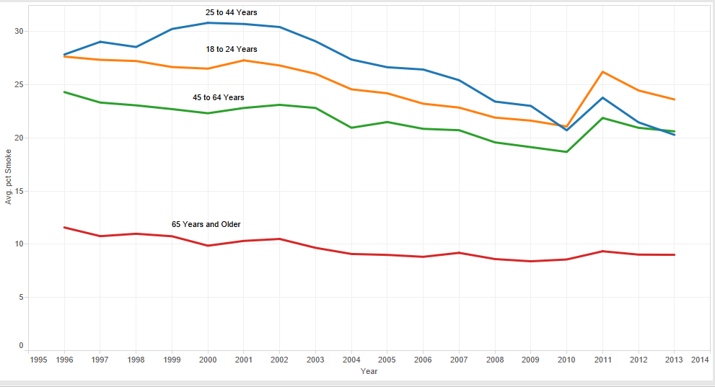
Percent Smokers by Age
Age Groups
18-24 Years
25-44 Years
45-64 Years
65+ Years
Notes:
This slide talks about the percentage of smokers of different age groups across different years ie; from 1996 to 2013. The survey question was-- do you smoke now-- and the answers were yes or no.
As you can expect ppl from the age group 25 to 44 have the highest percentage of smoking followed by ppl in the age group of 18 to 24 years. And less of the people in the age group 65 years and older currently smoke

Slide 8
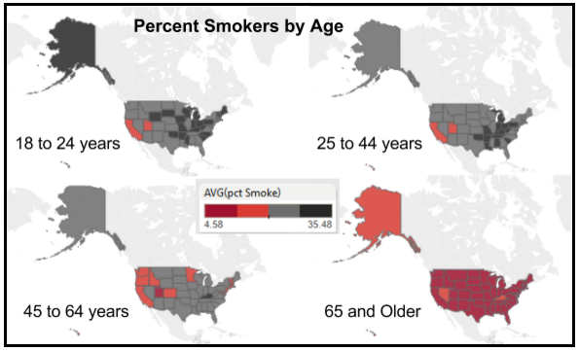
Average Percent Smokers by Age
Notes:
Percentage smoking of different age groups across the United States. There is lot of variation across the states

Slide 9
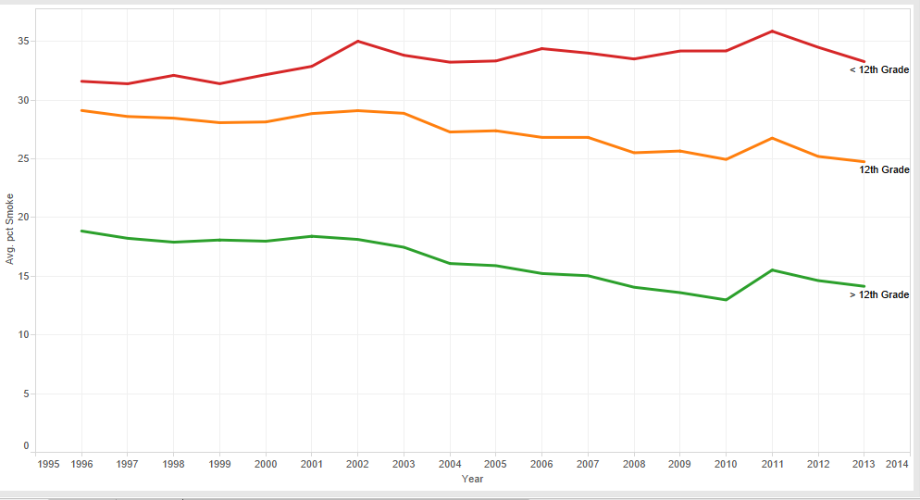
Percent Smokers by Education Level
Education Levels
< 12th Grade
12th Grade
> 12th Grade
Notes:
Same as Age

Slide 10
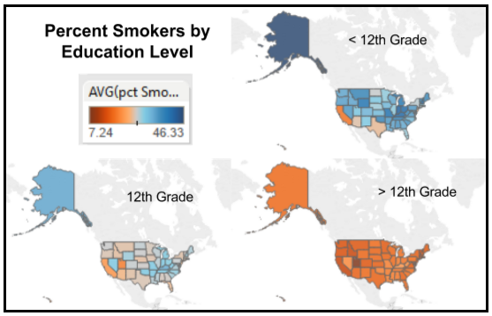
Average Percent Smokers by Education Level
Notes:
People with less education smoke more.

Slide 11
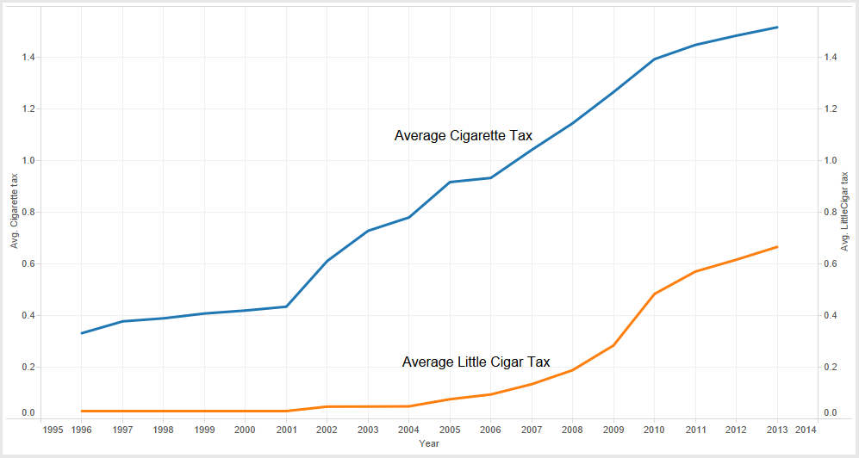
Average Cigarette & Little Cigar Taxes by Year
Notes:
These are the taxes on a pack of cigarettes and cigars

Slide 12
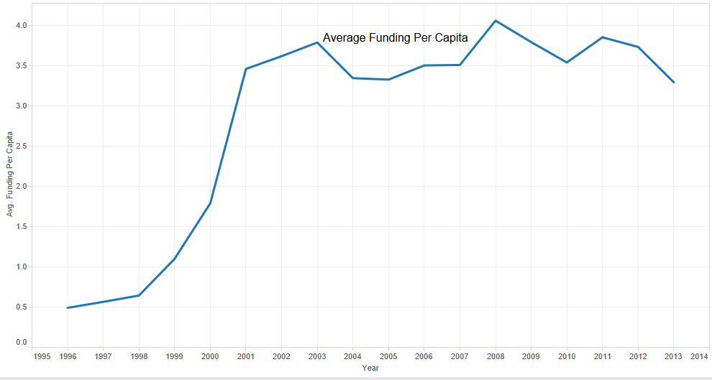
Average Policy Funding Per Capita
Master Settlement Agreement creates the American Legacy Foundation
Notes:
This shows average dollars spent per person. Sources for these funding are a combination of both public and private agencies. The big jump in average funding per capita that you see around 2000 is because of Master Settlement Agreement Funding the created the American Legacy Foundation that actually provided a huge funding for the tobacco control programs.

Slide 13
Modeling Approach
Correlation Analysis
Logistic Regression
Clustered Logistic Regression
PCA & Logistic Regression

Slide 14
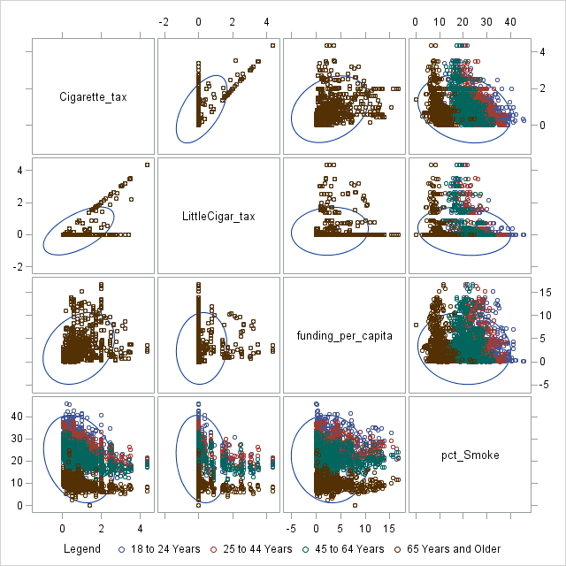
Age Dataset: Correlation Scatter Plots
Notes:
No age coloring can been seen for cigarette tax, little cigar tax, or percent funding because these are derived from data that cannot be broken up by age and thus is identical for all age groups.
The comparison of cigarette taxes and little cigar taxes, the strongest correlation within the data, shows that many states do not tax little cigars at all, some states tax little cigars and cigarettes identically, and some states tax little cigars at a lower rate than cigarettes. The second strongest correlation is between cigarette taxes and percent smokers with a correlation between -0.5 and -0.4 depending on the age group. There is low correlation between cigarette taxes and tobacco-related funding per capita and between little cigar taxes and percent smokers. There is even less correlation between funding per capita and percent smokers, and almost no correlation between little cigar tax and funding per capita. Therefore, for the dataset based on age, age and cigarette tax are likely the best modeling variables.

Slide 15
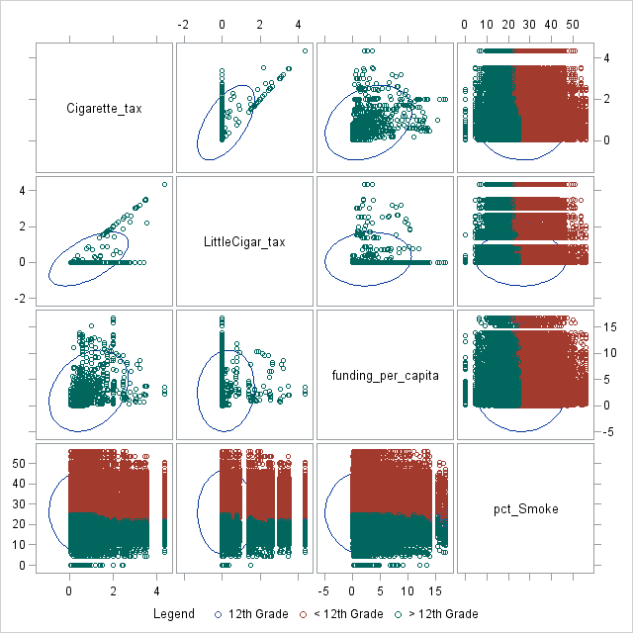
Education Dataset: Correlation Scatter Plots
All correlations less than 0.3.
Notes:
The correlation statistic for each of the variables against percent smokers is less than 0.3. Like the age data, the top two correlations are between cigarette tax and funding per capita and cigarette tax and percent smokers, respectively.

Slide 16
Base Model: Logistic Regression
Dataset | Input | Target | Selection | Significant Variables | Adj. R-Sq. | AIC
By Age | cigarette tax, little cigar tax, funding per capita, age groups | Percent smoker | Full | cigarette tax, age groups | 0.7374 | 7338.16
 |  |  | Forward selection |  | 0.7376 | 7334.4
By Education | cigarette tax, little cigar tax, funding per capita, education groups | Percent smoker | Full | cigarette tax, education groups | 0.6838 | 309699.9
 |  |  | Forward selection |  | 0.6838 | 309702.7

Slide 17
Clustering States
K-Means (K = 5 & K = 15)
Input: Smokefree Indoors Legislation
Restrictions (0=None, 1=Partial, 2=Complete)
Penalties (0=No, 1=Yes)
Hotels Restaurants | Bars Vehicles
Business Smoker | Driver

Slide 18
K=5 Clusters
Cluster | # Records | Characteristics
1 | 309 | Partial ban in Restaurants; No ban in Bars; Penalizes Restaurants
2 | 28 | Ban Vehicles; Punish Driver
3 | 1 | Ban Vehicles; Punish Driver
4 | 301 | No ban in Restaurants, Hotels, & Bars
5 | 279 | Ban Bars, Restaurants, & Hotels; Penalize smoker and business in bars & hotels & restaurants

Slide 19
K-Means Clustered Regression (Age)
Dataset | Input | Significant Variables | Adj.R-Sq. | AIC
By Age | cigarette tax, little cigar tax, funding per capita, and age groups | cigarette tax, age groups | 0.7376 | 7334.4
By Age k=5 | cigarette tax, little cigar tax, funding per capita, age groups, cluster assignments | cigarette tax, age groups, cluster assignments | 0.7409 | 7194.09
By Age k=15 |  |  | 0.7527 | 7084.2

Slide 20
K-Means Clustered Regression (Education)
Dataset | Input | Significant Variables | Adj.R-Sq. | AIC
By Education | cigarette tax, little cigar tax, funding per capita, and education groups | cigarette tax, education groups | 0.6838 | 309702.7
By Education k=5 | cigarette tax, little cigar tax, funding per capita, age groups, cluster assignments | cigarette tax, age groups, cluster assignments | 0.6833 | 309508.4
By Education k=15 |  |  | 0.6838 | 309376.3

Slide 21
PCA & Regression
Dataset | Input | Significant Variables | Adj.R-Sq | AIC
By Age | cigarette tax, little cigar tax, funding per capita, and age groups | cigarette tax, age groups | 0.7376 | 7334.4
By Age k=5 | cigarette tax, little cigar tax, funding per capita, age groups, cluster assignments | cigarette tax, age groups, cluster assignments | 0.7409 | 7194.09
By Age k=15 |  |  | 0.7527 | 7084.2
By Age using PCA | Components 1-12 | Components 1,8-Leg. & Funding 5,6-Age | 0.7366 | 7232.0

Slide 22
Insights
Higher cigarette taxes decrease the odds that an individual will smoke
Smokefree legislation restricting smoking in restaurants, bars, and hotels reduces the odds of an individual choosing to smoke
Policy funding has no significant impact on smoking rates.

Slide 23
Recommendations
States should maintain high taxes on cigarettes to reduce smoking rates
States should continue to explore smokefree indoors policies
States should carefully analyze the success of funding for tobacco programs

Slide 24
Thank you!

Slide 25
Appendix

Slide 26
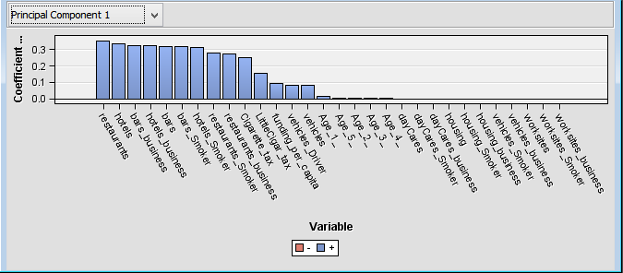
Principal Component 1

Slide 27
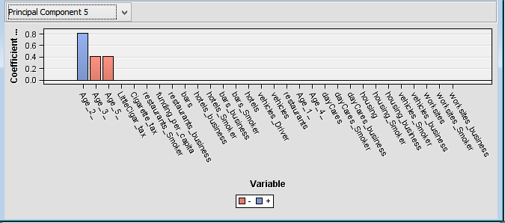
Principal Component 5

Slide 28
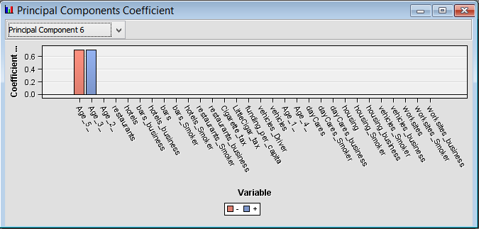
Principal Component 6

Slide 29
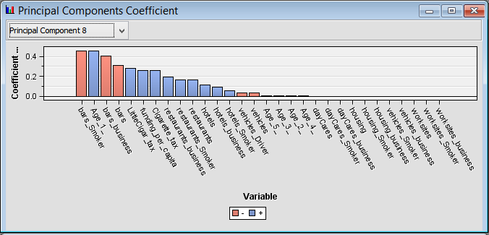
Principal Component 8

